Slide 1

Communicating your findings to ‘hard to reach’ public audiences
Lessons from medical research translation and social marketing
Johanna Bell, Menzies School of Health Research
Notes:
Intro Menzies – has for many years specialised in Indigenous health research, but broadening to concentrate more on social determinants of health and social program evaluation. Part of the newly established Centre for Child Development and Education research. Focus on evaluations of education, child protection, parenting and child development programs, particularly with Indigenous children.
Intro self – first AES conference. First time submitting an abstract/paper…
Note that the presentation title is a little misleading . Should probably be called ‘Communicating your findings to multiple audiences including hard to reach ones because we look at
Main aim of the presentation is to promote thinking about how we as evaluators can play an increased role in the communication of findings to a range of audiences and to reflect on some examples from two case studies – 1 using a medical research translation model and the other which uses a social marketing/health promotion principles. The case studies relate to work done with remote Indigenous populations and provide some insights into approaches to use for communicating findings to audiences who might normally be considered hard to reach

Slide 2

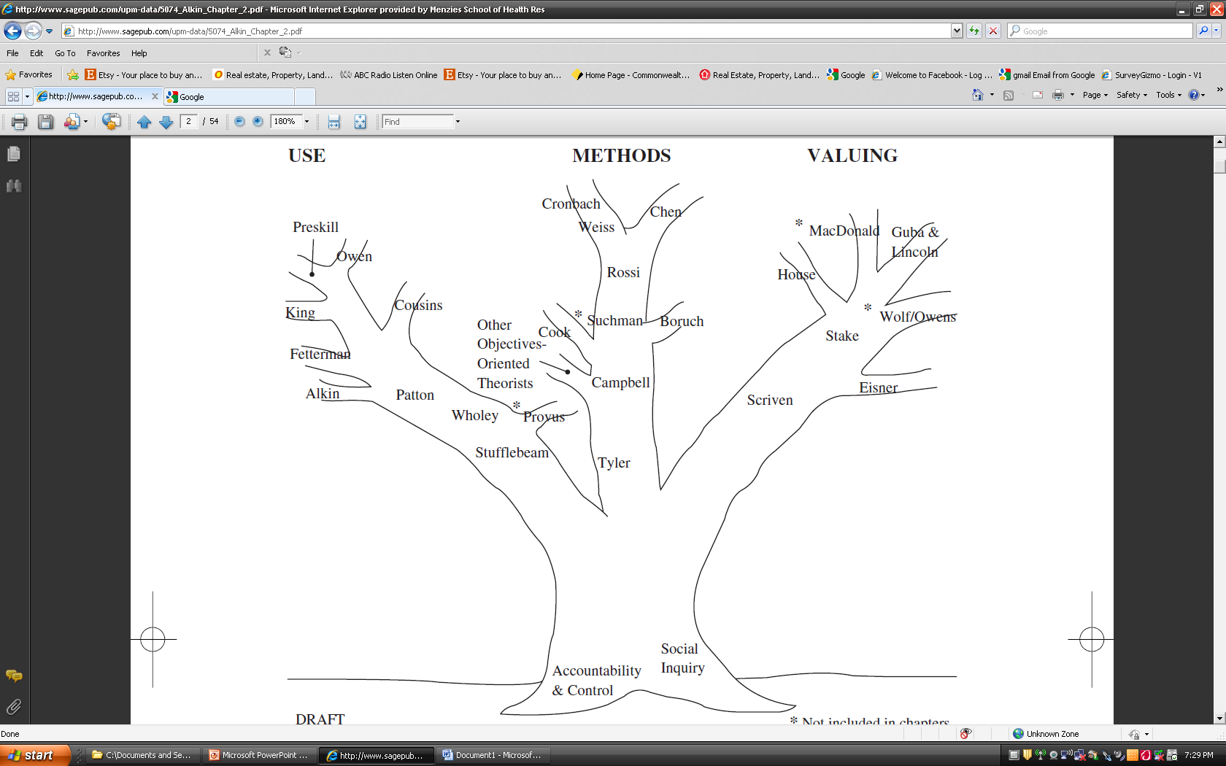
Alkin & Christie’s Evaluation Theory Tree, 2004
Notes:
2
I’m very much of the opinion that if an evaluation’s not going to be useful, then there is no point doing it.

Slide 3

Snapshot
Potential benefits of translating findings for audiences beyond policy/program managers
Using a medical research translation model to frame evaluation translation
Using multimedia social marketing products to support the transfer of findings to ‘hard to reach’ audiences
Looking at who should be responsible for evaluation transfer?
Notes:
3
Additional audiences such as evaluation participants, practitioners, fellow evaluators/academics/researchers and key public audiences.

Slide 4
Thinking about evaluation use
System level focus, developing processes for system level change
3rd generation
Knowledge Integration
Knowledge Exchange / Translation
Focus on individual policies, programs, organisations
2nd generation
Knowledge Transfer
Communication, dissemination, focus on packaging results
1st generation
Notes:
4
This presentation looks predominantly at processes involved in knowledge transfer
For those of you who saw Sandra Nutley’s key note speech yesterday morning, you’ll remember her mentioning that there has been considerable development in the thinking about evaluation utilisation over the last 15 – 20 years.
The first generation of thinking was called knowledge transfer, after which came knowledge translation and currently, the latest generation of thinking, known as knowledge integration…
Sandra Nutley said yesterday that there needs to be a shift away from packaging results to instead increase the focus on the players and processes involved in the evaluation use process.
I agree, however, it’s important to remember that each generation of thinking about evaluation use builds on the previous generations of thinking. Hence, we’re not getting rid of the knowledge transfer notion that findings need to be communicated in ways that are targeted, accessible and relevant to particular audiences. Instead we’re building on it.
It’s important that evaluators have a good understanding of knowledge transfer and what tools we have at hand to support that. The two case studies presented today will hopefully provide some examples of potential frameworks or tools for evaluation transfer.

Slide 5

Maximising influence
Maximising influence => maximising change
Maximising change => increasing awareness & understanding of evaluation findings beyond policy makers & program managers to multiple audiences
Notes:
At its heart, evaluation is about social betterment, and one of the main vehicles used by evaluators to contribute to social betterment is our capacity to influence change in policy, organisations, programs, projects and individuals. In short, the broader an evaluation’s reach, the greater the potential for influencing change.
Change can occur at many levels: system level, program level, project level, organisation level, individual level.
Increasing an evaluation’s influence involves maximising awareness and understanding of findings among multiple audiences.

Slide 6
Familiar territory
Evaluators are well versed in communicating findings to policy makers and program managers
Much effort goes into presenting findings in a format which meets the expectations of the primary audience (often the evaluation commissioner)
So it should! They are the primary audience…but…
…we risk overlooking opportunities to translate findings to additional audiences
Notes:
Currently, evaluators of social interventions are well-versed with communicating findings for policy makers and program providers, but less practiced at translating findings to broader audiences.
This is no accident. Leading evaluation theorists such as Stufflebeam, Wholey, Alkin and Owen have constantly reminded us about the importance of centralising the primary audience in the design and delivery of evaluations (Alkin & Christie, 2004).
Since the primary audience is often also the commissioner of the evaluation, it is not surprising that evaluators’ efforts to disseminate findings are often focused on meeting the needs of the primary audience.
But in our rush to respond to the primary audience, we risk overlooking opportunities to translate findings to other audiences, namely participants, practitioners, the broader public and our peers.

Slide 7

Written evaluation reports
The written evaluation report is king!
But its domination is a blessing and a curse
Notes:
As an early-career evaluator, I learned quickly that the written evaluation report is king.
It would be unusual to conduct a sizeable evaluation without producing a written evaluation report. This is not surprising given evaluations are commonly commissioned by agencies involved in policy design or program provision. Written reports are aligned with the language and cultures of these agencies and provide a useful way of translating evaluative findings from evaluators to commissioners.
Written evaluation reports can be a blessing and a curse for evaluators: a blessing in that they are familiar to both commissioners and evaluators and provide a common language by why to present evaluation findings. A curse because they blinker both evaluators and commissioners from alternative knowledge translation mechanisms and make the choice of a written report automatic rather than informed.

Slide 8
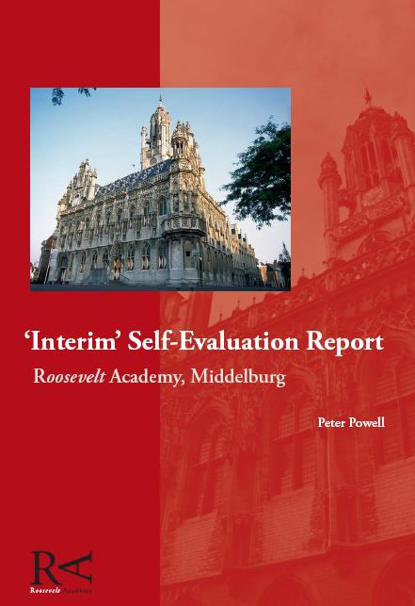
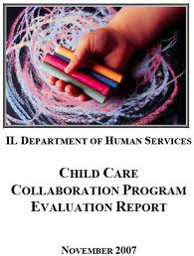

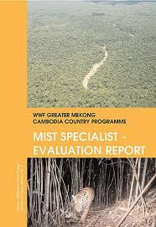
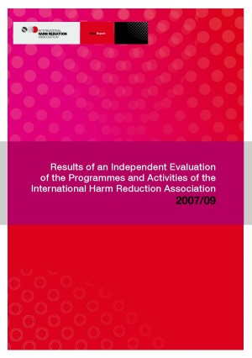
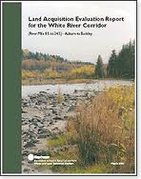
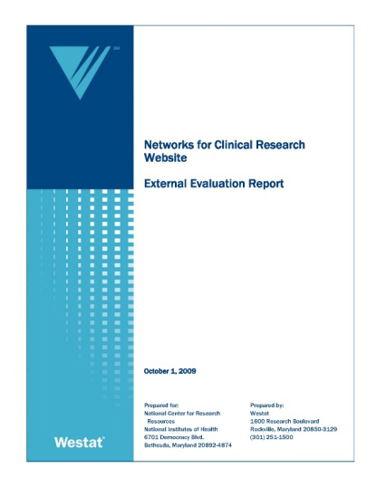
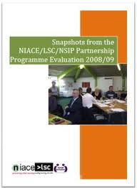
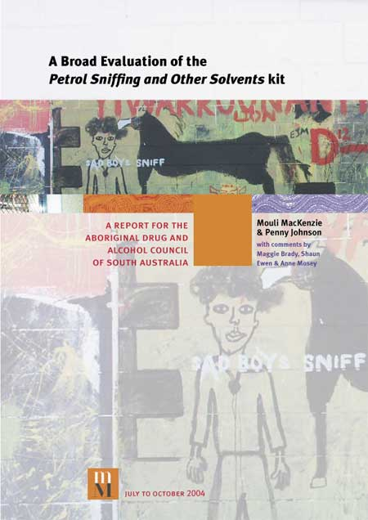
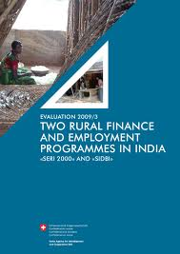
Written evaluation reports
Notes:
Written evaluation reports can be a blessing and a curse for evaluators: a blessing in that they are familiar to both commissioners and evaluators and provide a common language by why to present evaluation findings. A curse because they blinker both evaluators and commissioners from alternative knowledge transfer mechanisms and make the choice of a written report automatic rather than informed.
Don’t get me wrong. I’m a big fan of the written evaluation report and understand its importance as a tool for influencing areas such as policy, program management and strategic planning.
BUT, written reports are often inaccessible to other key audiences. – length, language, text heavy, static can take a lot of reading, key messages are diluted.
While many evaluators would agree that evaluation reports are a good medium for presenting evaluation findings to policy and program management audiences, they are not necessarily accessible, relevant or appealing to other key audiences such as practitioners, evaluation participants and the broader public, who could also benefit from learning about an evaluation’s results.

Slide 9
Knowledge flow
Data collection
Analysis & reporting
Client deliverables
Dissemination
Stakeholder interviews
Presentations?
Meetings?
Client focus groups
?
Written evaluation report
Literature review
Commissioner receives report
Client & stakeholder survey
Workshops?
Practitioner observation
Online report?
Notes:
For many commissioned evaluations, the flow of knowledge generated from the evaluation looks something like this.
Lots of groups involved in contributing to the evaluation
Evaluators responsible for synthetising data into a written report with key findings (degree of participation from stakeholders would differ from very involved with participatory methods to uninvolved if totally independent evaluation)
Written report is produced and provided to the client.
Depending on the method and budget of the evaluation, the provision of the evaluation report might be accompanied by presentations, meetings, workshops etc to support communication of findings, most likely to the commissioner. Report could be sent to participants and other stakeholders. Report could be made available online.
End of evaluator’s involvement in translating the evaluation findings and onus is on commissioner to conduct the dissemination/ translation activities.
I’m sure many of you are familiar with this example of knowledge flow. I can think of at least a couple of evaluations I’ve worked on where the commissioning agency has been responsible for knowledge transfer provided no information about how they’ve used the findings provided to them, or whether they have made a conscious effort to disseminate the findings.
This translation approach puts all the onus on the commissioner to disseminate evaluation findings to additional audiences including those directly involved in the evaluation.
Essentially, the evaluator absolves all responsibility for the communication/translation of evaluation findings to the primary audience or commissioner of the research.
Some of you might be thinking…. ‘It’s not the evaluator’s responsibility to communicate/disseminate findings from the evaluation. That’s the work of the commissioning agency.’
It poses a good question – With whom should the responsibility for disseminating evaluation findings sit? If it sits with the commissioner, what role should the evaluator play?
My view is that the more involved evaluators are, the better as there are a number of direct benefits which flow from increased evaluator involvement in the translation of findings.

Slide 10
Potential benefits
Increased influence and assurance
A more ethical approach
Greater opportunities to utilise evaluators’ established relationships
New area of specialisation for evaluators
Notes:
Communicating evaluation findings to multiple audiences is more expensive and resource intensive than delivering findings to one primary audience, so why bother investing in a multi-audience translation strategy?
There are 4 main reasons which relate to maximising influence, ethical responsibility, capitalising on established relationships and building a new area of specialisation for evaluators.

Slide 11

Increased influence & security
More audiences = more chance of utilisation
Diminished risk of having evaluation findings ‘shelved.’
Accountability in numbers
Helps protect evaluation from shifting political backdrops
Notes:
Instead of delivering findings to one audience via a single format (e.g. a written report), evaluators can increase the potential that their findings will be utilised by designing translation strategies for multiple audiences.
In doing so, evaluators diminish the risk that their evaluation’s influence will cease if someone, somewhere decides to shelf the evaluation report.
The tenuous relationship between evaluation and politics is well documented and the threat presented by changing political backdrops is a danger for evaluators who have placed all their translation strategies in a ‘single-audience, written report’ basket. By reducing dependency on the written report and the primary audience for disseminating evaluation findings, evaluators can effectively insure themselves against the risk that their findings could be shelved.

Slide 12
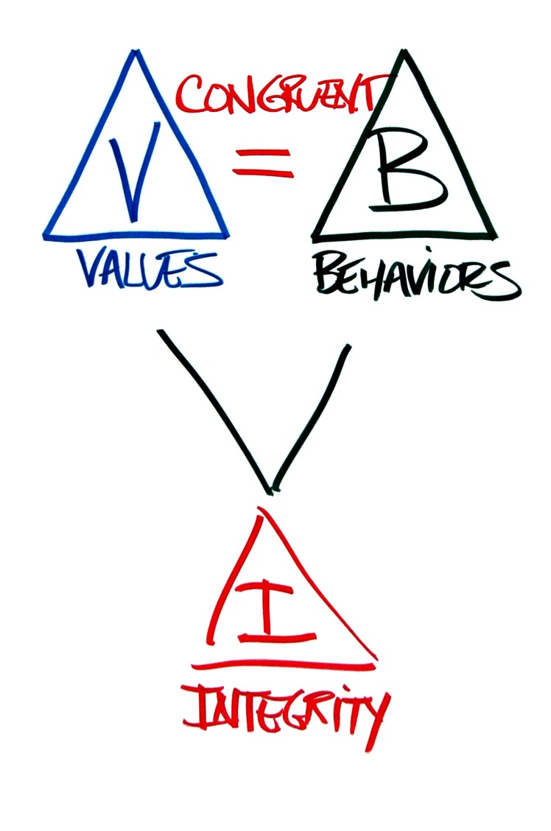
A more ethical response
Improve the reputation of evaluation industry
Restore trust in evaluators
Help combat ‘evaluation fatigue’ in over-researched populations
Empower participants through the provision of information
Notes:
12
Ethics in evaluation is all about making sure our values are aligned with our practices.
Peak evaluation bodies such as the AES have placed value on the provision of feedback to a range of stakeholders through their Guidelines for Ethical Conduct of Evaluations and their Code of Ethics.
For example, the Australasian Evaluation Society’s Guidelines for the Ethical Conduct of Evaluations states that “The results of the evaluation should be presented as clearly and simply as accuracy allows so that clients and other stakeholders can easily understand the evaluation process and results,” (AES, 1997, p.12).
Similar themes have been reiterated by bodies such as the American-based Joint Committee on Standards for Educational Evaluation who outlined in their 1997 propriety standards that evaluation findings should be made accessible to all persons affected by the evaluation (Sanders, 1994).
BENEFITS
Prioritising the communication of evaluation findings beyond policymakers and program managers also has the potential to improve the standing and reputation of the evaluation industry.
In particular, the consistent provision of findings to evaluation participants and other interested stakeholders has the potential to increase trust in evaluators and undo any damage done by evaluators who have not provided feedback.
One of the common criticisms of evaluators in remote Indigenous contexts is that they take away information but fail to provide any feedback to evaluation participants at the community level. This practice has contributed to well-documented evaluation fatigue among Indigenous populations who are tired of being continually consulted without any feedback or follow-up (ALRC, 2010, DEECW, 2010).

Slide 13
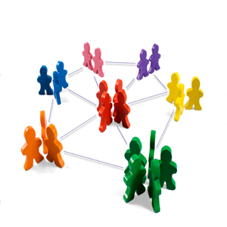
Utilisation of relationships
Evaluators establish relationships with a range of stakeholders during an evaluation
These relationships provide potential springboards for feedback/dissemination
They make evaluators particularly well-placed for involvement in feedback
Relationships can’t be ‘handed over’ to a client
Notes:
13
During the life of an evaluation, evaluators develop working relationships with a range of stakeholders including collaborators, commissioners, service providers and service users. These relationships differ in depth and breadth depending on the evaluation approach used, but each relationship provides a potential springboards for the delivery of feedback about evaluation findings.
These relationships locate evaluation practitioners particularly well for involvement in feedback as they’re a naturl continuation of dealings with stakeholders. Provides a way to remain accountable to stakeholders/build relationships for future evaluation work.
Unlike an evaluation report, these relationships can not be ‘handed over’ to a commissioning agency at the end of an evaluation. If an evaluation ends with the provision of a written report, then there is a risk that these opportunistic avenues for communicating key findings will remain unutilised.
When working with small, tight-knit communities, the relationships established by evaluators with stakeholders provide a ‘natural window’ for disseminating key findings, especially where accessing ‘hard to reach’ audiences such as Indigenous and culturally and linguistically diverse communities are concerned.
For example, if an evaluator has developed a strong, working relationship with an Indigenous health worker during the course of an evaluation, this individual provides entrance point for the provision of information to service users or research participants. Similarly, if a partnership with an individual school has been forged during an evaluation, existing relationships with the principal and teaching staff provide natural opportunities for disseminating evaluation findings to other staff, parents and students.

Slide 14

New area of specialisation
Evaluators are well placed to increase their involvement in feedback/findings translation
Potential for new area of specialisation / business development for evaluators
Notes:
14
By taking more responsibility for the dissemination of findings to multiple audiences, we are creating a new area of specialisation for evaluators and the evaluation industry.
By prioritising the translation of findings to multiple audiences and positioning evaluators as experts in knowledge translation, the evaluation ‘lifecycle’ is extended and so too is work for the evaluator.
So that’s a brief look at some of the potential benefits of increasing evaluators’ involvement in the transfer process.
If we agree that having evaluators involved in the translation of findings to multiple audiences is beneficial, the next logical question is ‘how do we translate the findings to diverse audiences?’
There’s many ways. I’m going to show two quick examples of strategies which Menzies has used to help translate research findings to stakeholders in remote Indigenous communities.
The first case study involves the mobile preschool evaluation.

Slide 15

Research Translation Model
Impact Metrics
Govern-ment
Research Findings from Mobile Preschool Evaluation
Policy
Educators
Practice
Public
Behaviour
Academia
Advancement
Industry
Adapted from the UK-SBRP Research Translation Model
Application
Notes:
15
The Mobile Preschool Program evaluation, a quasi-experimental study, found that increased preschool attendance is associated with increased school readiness among Indigenous five year living in remote Northern Territory.
The Mobile Preschool evaluation team wanted to ensure that research findings reached four distinct audiences: policymakers (in relevant Northern Territory and federal government departments); practitioners (principals, teachers, assistant teachers and other professionals working in remote early childhood education); the public (in particular, the carers of remote Indigenous children); and, academics (primarily those working in education and health research).
The MPP evaluation team used a medical research translation model from the University of Kentucky to frame their feedback process. In this model, there are 5 ‘impact metric’ areas: government (policy), health professionals (practice), the public (behaviour), academia (knowledge advancement), and industry (application), (University of Kentucky, 2011).
Each of these audiences has its own culture, processes and protocols which means that influencing change requires the translation of findings so that they are accessible, understandable and relevant for individual audiences.
One of the benefits of using the biomedical research translation model for framing the Mobile Preschool Evaluation’s translation process was its distinct separation of policy and program management from other translation audiences. This model encouraged evaluators to consider all audiences, discuss the differences between each and identify targeted communication strategies for each discrete audience.
The result involved targeted strategies designed specifically for each audience.

Slide 16
Research Translation Model
MPP Research Transfer Activities
Impact Metrics
Dept. Education & Training
Final evaluation report
Round table discussions
Collaboration on future trials
Policy
Principals, Teachers,
Educators
Regional workshops with principals, teachers & ECS
Face-to-face feedback with assistant teachers supported by purpose-built flipchart
Practice
Participants, carers,
community
Flipchart for assistant teachers to use with parents
Posters for school / store / Clinic
Meetings with parents in communities
Behaviour
Education & Health academics
Articles in education and health journals
Conference Presentations
Advancement
Notes:
16
Go through examples of translation strategies. Concentrate on participants and ATs
By locating the research translation process within the Mobile Preschool evaluation plan and by giving evaluators responsibility for designing and managing the translation process, evaluators were able to utilise many of the relationships, networks and contacts they had developed over the course of the two year evaluation.
One of the challenges in the MPP transfer approach was designing processes for communicating findings to carers of children aged 3 – 5 yrs. Language diversity, literacy variation.
The next case study provides an example about how multimedia and social marketing principles can be used to develop tools which help support the translation of research or evaluation findings to audiences where varied literacy might normally present a challenge. It’s the product of a Menzies project called Grog and the Brain,

Slide 17

Grog and the Brain
Notes:
17
The Grog and The Brain animation was designed to increase understanding about how alcohol affects the brain among Indigenous people at risk of heavy drinking. Animation was chosen as it cuts through traditional barriers to information sharing such as varied literacy skills or English as a second language. This animation was translated into a number of Northern Territory Indigenous languages.
While this example relates to the transfer of research/science it provides an example of how multimedia tools can be used to support the communication of complex information in a way that is engaging, relevant and accessible.
Show animation
It provides the opportunity to create characters and to tell stories. To use visual aids and audio to reinforce the uptake of key messages
It’s possible to create different voice overs, genders and to use different languages.
It can incorporate humour and sustain engagement in a way that a written document can not.
It can provide a way to communicate information in a friendly, accessible way where face-to-face delivery is not possible.
It’s also cheap to house online and easier and cheaper to distribute than hard copy resources.
This same type of animation product could be utilised by evaluators to provide feedback about key evaluation findings. For example, evaluation participants who want a snapshot of what was found in the evaluation they contributed. Target groups from the public, e.g. service clients, practitioners to wet the appetite about the findings and raise interest in other translation products such as written reports or new guidelines.

Slide 18
Take home messages
Well planned, well-resourced research transfer strategies are important
Reaching multiple audiences and increasing evaluator involvement in transfer has potential benefits
Medical research transfer models provide ready-made frameworks for evaluation transfer
Evaluators could work more closely with multi-media specialists to develop innovative products for supporting transfer

Slide 19
Acknowledgements
Menzies School of Health Research
  Mobile Preschool Evaluation team, especially Georgie Nutton & Julie Fraser
  Healing and Resilience team, especially Sheree Cairney
Remote community members, NT Department of Education, NT Department of Health, AMSs
NHMRC, AER
Notes:
19

Slide 20

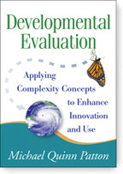
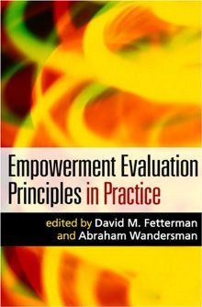
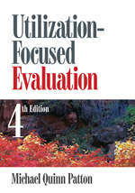
Significant inroads
Significant inroads have been made in the area of evaluation use/knowledge translation
Evaluation theorists such as Patton, Cousins, Fetterman & King have challenged us to conceptualise the translation of evaluation findings as an iterative process rather than a product
Notes:
20
Encouragingly, evaluation theorists such as Patton, Cousins and King have urged evaluators to conceptualise the translation of evaluation findings as a process rather than a product (Alkin & Christie, 2004), drawing focus away from the evaluation report and placing it on participatory processes such as presentations, workshops, seminars and training sessions.
The mainstreaming of participatory evaluation practices has meant that stakeholders are increasingly involved in evaluation design, delivery and management.
But in many cases, this involvement is not extended to the feedback stage or evaluation translation stage.

